Slide 1

TEST CG -­‐ ENDURANCE-­‐ FORCE ABDOMINALE

Slide 2
!"#$ &' ( ")*+,-)."(/0,." -1*023)-4"
"#$%&#' ()#*+%&,*-# . /0&-# +#$ 1%$-(#$ ,2+013*,%4 #* &#$5#-6,*6 (, 2307 18-,*39%# +# -#%47-3 :
&0)#35)"# 6
;# $%<#6 #$6 ,((0*=8 (# +0$ $%& (# =&0$ 2,((0* 9%3 +036 >6&# 23#* =0*/(8?
- ;#$ =#*0%4 $0*6 /(8-@3$ A BCD #6 (#$ 53#+$ $0*6 #* ,55%3$ $%& (# $0(?
- ;#$ (012,3&#$ &#50$#*6 $%& (# 20&+ +% 2,((0* E 50$3630* +),66#*6# FGH?
- ;#$ 2&,$ $0*6 -&03$8$ $%& (, 5036&3*#?
- IJ,*6 +# +82%6#& (# 6#$6K (# $%<#6 +036 -0*6&,-6#& (#$ 1%$-(#$ +%
58&3*8# #6 &#*6&#& (# J#*6&# #* $0%//(,*6 F6&,*$J#&$#H?
- L%&,*6 (# 6#$6 (# J#*6&# *# +036 5,$ $# M)2012#&))?
- ;# $%<#6 +036 1,3*6#*3& (# 5(%$ (0*=6#15$ 50$$32(# ,((0*=8K #* 3$0186&3#

Slide 3
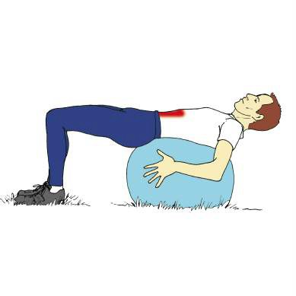
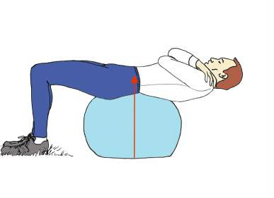


TEST CG -­‐ ENDURANCE-­‐-­‐-­‐FORCE ABDOMINALE
7"#+,"# 6 89.4").:", 4" .:,0)02;$," *;# <+" (# $%<#6 , &#-%(8 $%& (#
2,((0* = 4" #+>"$ "#$ 13") ?4-.9 40,#<+" #"# @ABC #0)$ D 4E-?4021 *+
.")$," *+ 1-440) FGH ( (# 2%$6# A ()@0&3'0*6,( N
O*/0&1#& (# $%<#6 +% 6#15$ 60%6#$ (#$ PC $#-0*+#$? I&&>6#& (# -@&0*01Q6&# (0&$9%# (# $%<#6 *# 5#%6 5(%$ 6#*3& (, 50$3630*?
G
T
R06,630* | S%58&3#%& A T 13* | T
 | U*6&# G 13* #6 G 13* VB | G
 | O*/8&3#%& A VB $#-0*+#$ | C
Lors de ce test, contrairement à d_{je}’_{a}a_{n}u_{m}t_{i}r_{ch}e_{el}(_{r}S_{e}h_{ym}ir_{o}a_{n}d_{d I}o_{NS}i_{E}t_{P}o_{p})_{o}la_{le f}l_{o}o_{r}r_{m}d_{a}o_{6o}s_{n}e est respectée
pas de compensa9on des ﬂéchisseurs de h^{c}a^{ad}n^{r}c^{es}h^{d}e^{u s}e^{p}t^{or}l^{t}es abdominaux sont en allongement.

